Slide 1


USHA MARTIN UNIVERSITY, RANCHI
FAKE NEWS DETECTION USING MACHINE LEARNING
Guided by
Presented by
Dr. Md. Amir Khusro Akhtar
Jitu Kumar (222025109181)
Submitted for the partial fulfillment
Of
Bachelor of Technology (B.Tech)
in
Computer Science And Engineering
Faculty of Engineering & Applied Sciences
06 - 2024
1

Slide 2
CONTENTS
Abstract
Introduction
Objectives
Methodology
Tools And Technologies
Data Collection / Data Analysis
Machine Learning Models
Verification And Model Testing
User Interface
Conclusion
Questions And Discussion
Faculty of Engineering & Applied Sciences
06 - 2024
2

Slide 3

ABSTRACT
Fake News has high potential to change opinions, facts and can be the most dangerous weapon in influencing society.
The proposed project uses a Machine Learning Model for detecting 'fake news', that is, misleading news stories that come from non-reputable sources.
The proposed project uses the datasets that are trained using the count vectorizer method for the detection of fake news and its accuracy will be tested using machine learning algorithms.
Faculty of Engineering & Applied Sciences
06 - 2024
3

Slide 4

INTRODUCTION
The rapid spread of news through social media and online platforms has transformed how we consume news but also made discerning the truth more challenging.
A great deal of fake news is roaring through the various social media platforms like Facebook, Twitter etc.
Fake news is a news designed to deliberately spread hoaxes, propaganda and disinformation.
Faculty of Engineering & Applied Sciences
06 - 2024
4

Slide 5

OBJECTIVES
The primary objective of the this project is to develop and implement a machine learning-based system capable of accurately identifying and classifying news articles as "fake" or "genuine.“
We will be working on different fake news data set in which we will apply different machine learning algorithms to train the data and test it to find which news is the real news or which one is the fake news.
Faculty of Engineering & Applied Sciences
06 - 2024
5

Slide 6
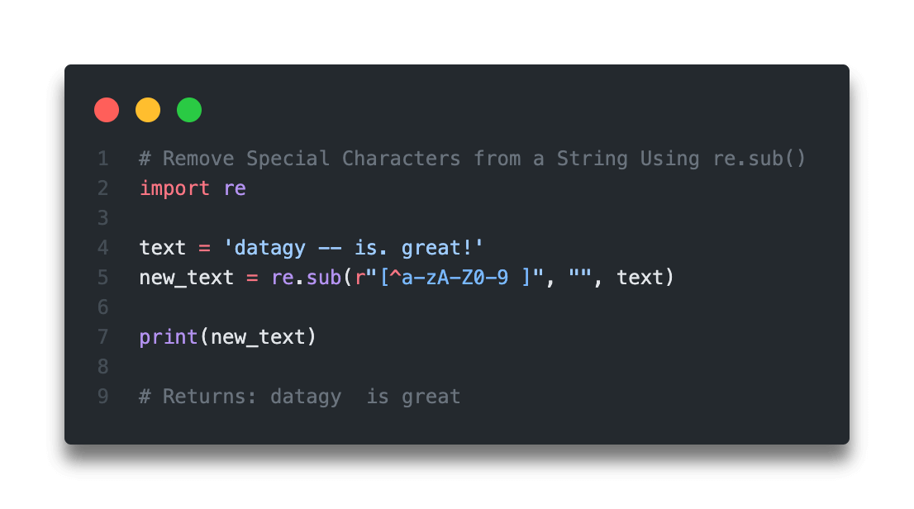
METHODOLOGY
1. Data Collection
Gather a labeled dataset of news articles (real or fake) from sources like Kaggle.
2. Data Preprocessing
Clean text data by removing HTML tags, special characters, and stop words.
Stop words such as "if," "the," "is," "a," and "an" should not be given much weight by a machine learning model because they are common English terms and do not contribute to the uniqueness or credibility of any narrative. Their presence in the dataset can affect the model's predictions due to their frequent usage.
Figure : Removal of Special Characters
Faculty of Engineering & Applied Sciences
06 - 2024
6

Slide 7
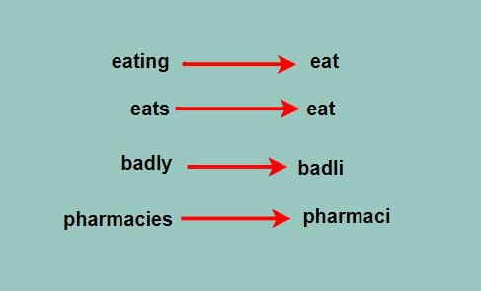
METHODOLOGY
Perform lemmatization and convert text to lowercase :
The word "play" acts as the base for other words like "playing" and "plays." Expanding the analysis of its frequency involves replacing the core word with its variations in different tenses and participles. Consequently, we substitute this word for any phrase derived from a single source word.
Figure : Transforming words to their base forms for more accurate text analysis.
Faculty of Engineering & Applied Sciences
06 - 2024
7

Slide 8
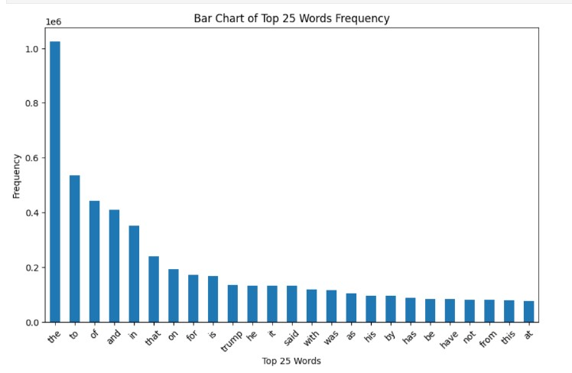
METHODOLOGY
3. Exploratory Data Analysis (EDA)
Analyze data distribution, word frequencies, and patterns in fake vs. real news.
Visualize data with plots and word clouds for insights.
Figure : Bar Graph of the Top 25 Most Frequent Words
Faculty of Engineering & Applied Sciences
06 - 2024
8

Slide 9
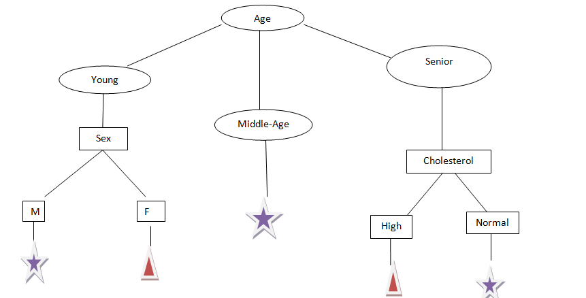
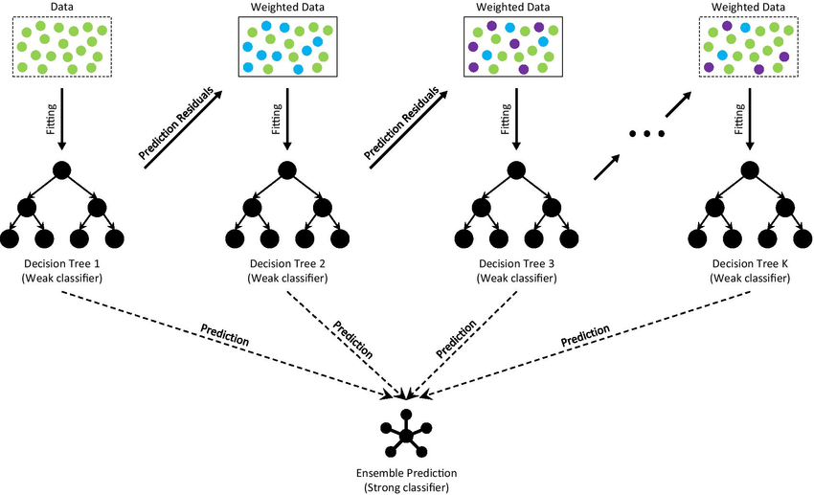
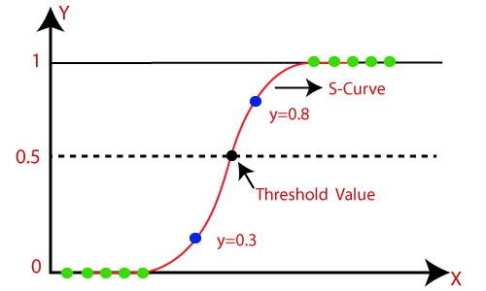
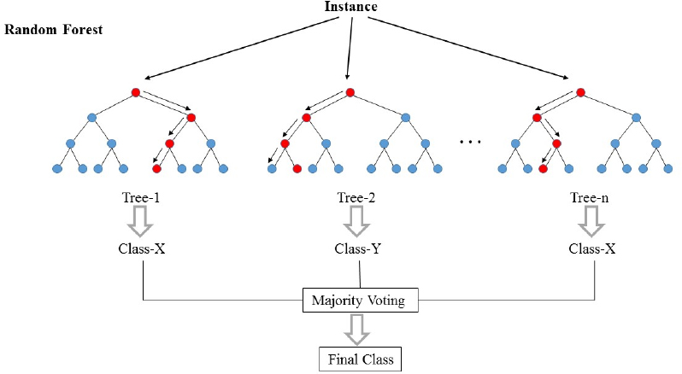
METHODOLOGY
4. Model Selection
Choose algorithms for classification:
Fig. (c) Decision Tree
Fig. (b) Gradient Boost
Fig. (a) Logistic Regression
Fig. (d)Random Forest
Faculty of Engineering & Applied Sciences
06 - 2024
9

Slide 10

TOOLS AND TECHNOLOGIES
1. Programming Language :
Python:
Python is a high-level, interpreted programming language known for its simplicity and readability.
It emphasizes code readability and has a large ecosystem of libraries and frameworks for various purposes, including web development, data analysis, artificial intelligence, and scientific computing.
Faculty of Engineering & Applied Sciences
06 - 2024
10

Slide 11

TOOLS AND TECHNOLOGIES
2. Data Collection :
Kaggle: For collecting news datasets.
Kaggle is a popular platform for data science competitions, datasets, and kernels.
Kaggle also provides access to a vast collection of datasets for practice, learning, and exploration.
3. Which Libraries we have used?
NumPy, Pandas, Matplotlib, Seaborn, Sklearn, and WordCloud
Faculty of Engineering & Applied Sciences
06 - 2024
11

Slide 12
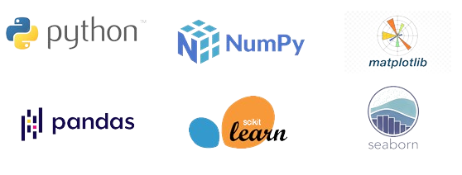
TOOLS AND TECHNOLOGIES
NumPy: NumPy is widely used in data science for tasks such as data cleaning, data manipulation, and data analysis.
Pandas: You can use Pandas to load data from a CSV file into a DataFrame. You can use Pandas to clean data by removing duplicates and filling in missing values.
Matplotlib: It allows users to create various plots and charts to represent and analyze data, identify trends and patterns, and make informed decisions.
Faculty of Engineering & Applied Sciences
06 - 2024
12

Slide 13
TOOLS AND TECHNOLOGIES
Seaborn: It simplifies the process of creating complex visualizations and offers support for advanced features like statistical estimation and multi-plot grids.
Sklearn (scikit-learn): It provides simple and efficient tools for data mining and data analysis, including various machine learning algorithms for classification, regression, clustering, dimensionality reduction, and model selection.
WordCloud: It is used for generating word clouds from text data. The library provides functionalities to create visual representations of the most common words in a text corpus, with the size of each word indicating its frequency in the corpus.
Faculty of Engineering & Applied Sciences
06 - 2024
13

Slide 14

TOOLS AND TECHNOLOGIES
4. Documentation and Reporting
Jupyter Notebooks: Documenting code, visualizations, and explanations.
Jupyter Notebooks is an open-source web application that allows users to create and share documents containing live code, equations, visualizations, and narrative text. It supports multiple programming languages, including Python, R etc.
Jupyter Notebooks are widely used in data analysis, machine learning, scientific research, and education for their ability to combine code, visualizations, and explanations in a single document, facilitating collaboration, exploration, and reproducibility of computational workflows.
Faculty of Engineering & Applied Sciences
06 - 2024
14

Slide 15
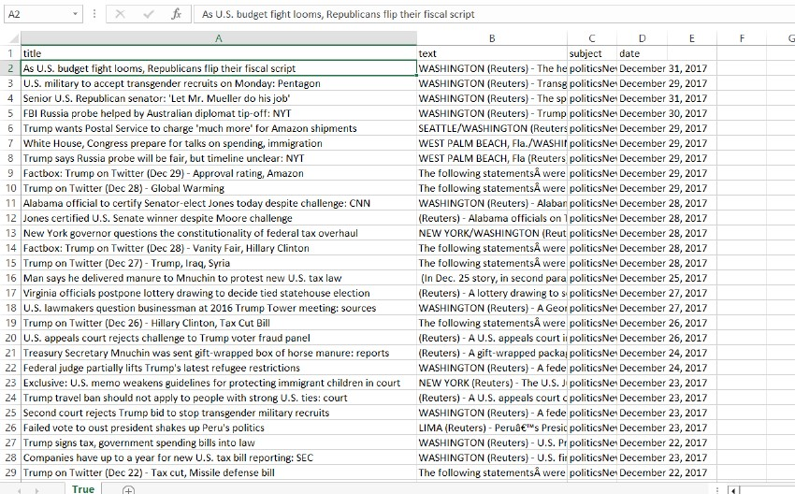
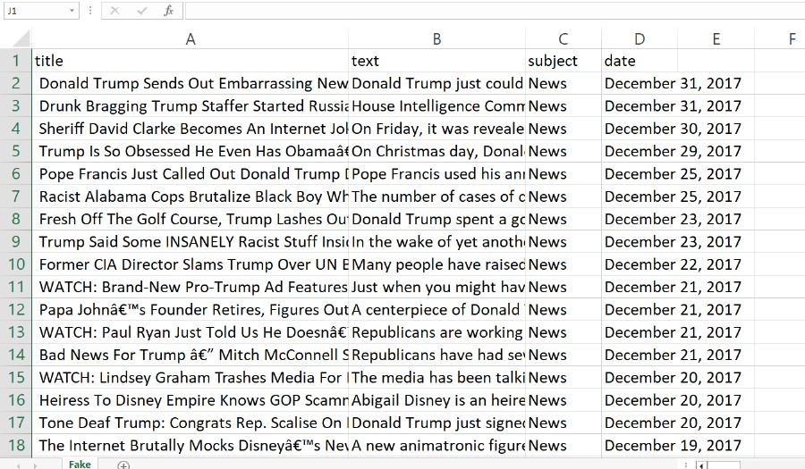
DATASETS
Fig.- True News Dataset
This dataset will contain articles that have been identified and labeled as true news.
Fig.- Fake News Dataset
This dataset will consist of articles that have been verified and labeled as fake news.
Faculty of Engineering & Applied Sciences
06 - 2024
15

Slide 16
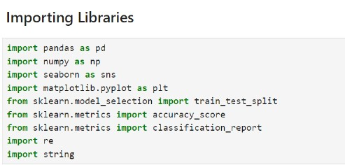
Importing Python Libraires
The next procedure to be followed is to launch jupyterlab using command prompt. The first step in jupyterlab is to import all the necessary libraries.
Figure : Importing Important Libraries
Faculty of Engineering & Applied Sciences
06 - 2024
16

Slide 17
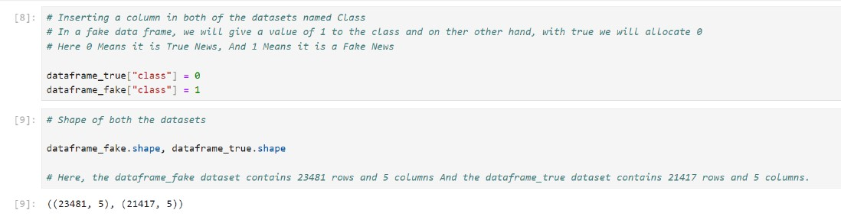
Shape of True And Fake News Datasets
Here, 0 Means it is True News, And 1 Means it is a Fake News.
Figure : Shape of both the Datasets
Faculty of Engineering & Applied Sciences
06 - 2024
17

Slide 18
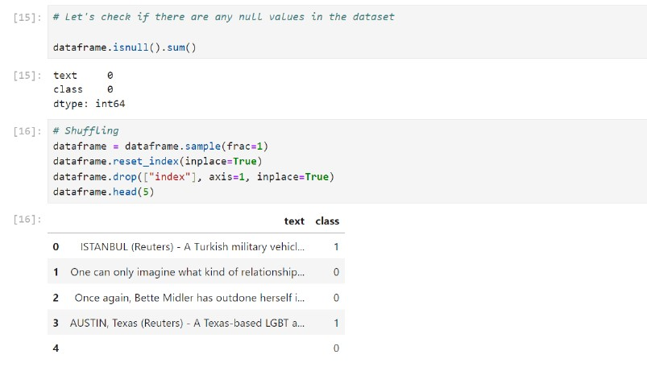
Check Null Values in the Datasets
After that, we check the null value in both datasets.
Figure : Check Null Values in the Datasets
Faculty of Engineering & Applied Sciences
06 - 2024
18

Slide 19
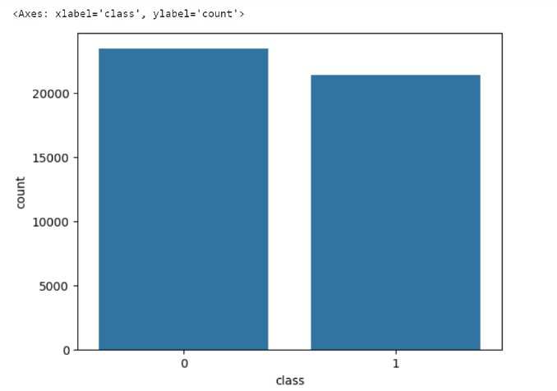
Explore the unique values in True And Fake Datasets
Now Let’s explore the unique values in each category. To explore the unique values in each category of the fake news and true news datasets, I am using Python programming language along with libraries such as Pandas for data manipulation.
Figure : Explore the unique values in each category
Faculty of Engineering & Applied Sciences
06 - 2024
19

Slide 20
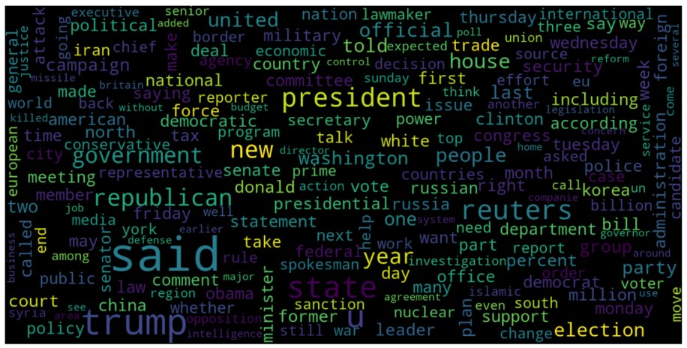
WordCloud visualizations for True News
A word cloud (or tag cloud) is a visual representation of text data where the size of each word indicates its frequency or importance within a given body of text. Words that appear more frequently in the text are displayed in larger font sizes, while less common words are shown in smaller sizes.
Figure : WordCloud visualizations for True News
Faculty of Engineering & Applied Sciences
06 - 2024
20

Slide 21
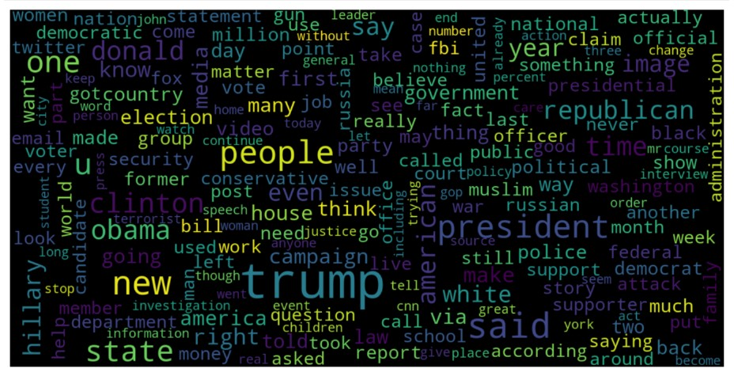
WordCloud visualizations for Fake News
Figure : WordCloud visualizations for Fake News
Faculty of Engineering & Applied Sciences
06 - 2024
21

Slide 22
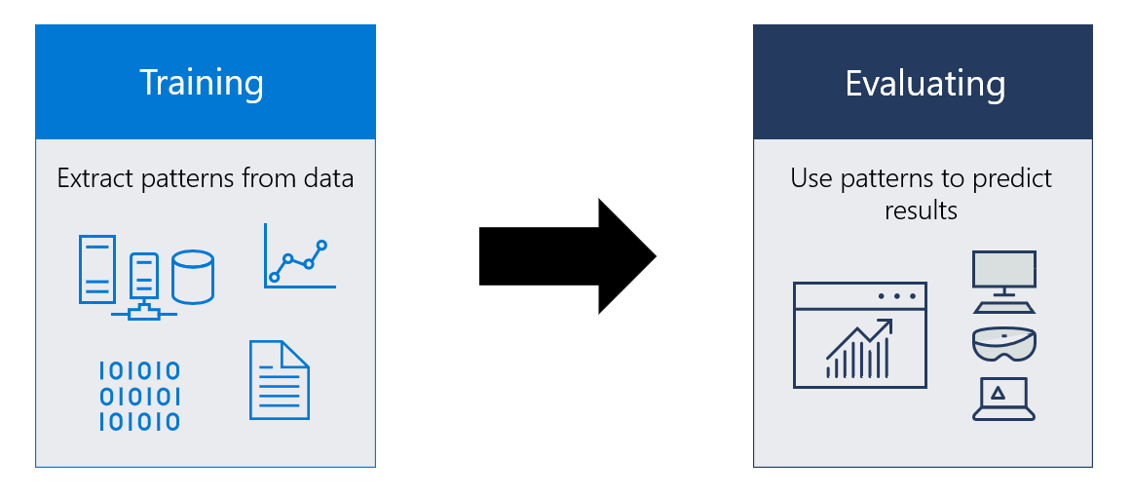
Machine Learning Models
Modeling involves creating a mathematical representation of a system or dataset by employing various techniques and algorithms. In this context, we'll utilize a range of machine learning algorithms to train them on the dataset, with the objective of predicting fake news.
Logistic Regression
Decision Tree
Gradient Boosting
Random Forest
Faculty of Engineering & Applied Sciences
06 - 2024
22

Slide 23
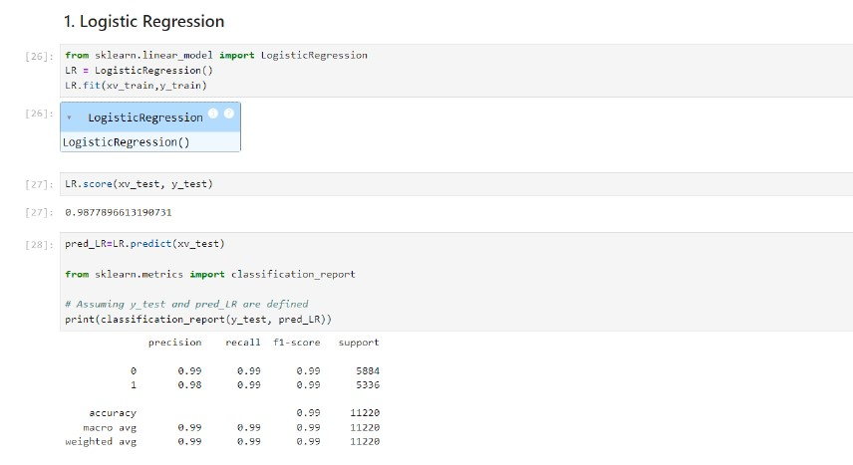
Logistic Regression
Logistic regression is a statistical method used in machine learning for binary classification tasks.
It models the probability that a given input belongs to a particular class.
Purpose:
To predict the probability of a binary outcome (e.g., yes/no, true/false, 0/1).
To classify data points into one of two categories.
Applications:
Spam detection (spam vs. not spam).
Medical diagnosis (disease vs. no disease).
Figure : Logistic Regression
Figure : Logistic Regression
Faculty of Engineering & Applied Sciences
06 - 2024
23

Slide 24
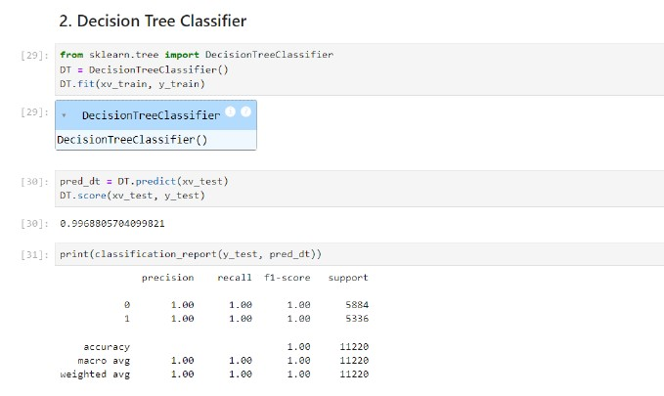
Decision Tree Classifier
A decision tree classifier is a supervised machine learning algorithm used for classification tasks. It recursively splits the dataset into subsets based on the values of input features, creating a tree-like structure of decision nodes.
Purpose:
To classify data points into multiple classes based on input features.
To represent a series of decisions as a tree structure.
Applications:
Credit risk assessment (approve vs. deny loan applications).
Customer segmentation (classify customers based on purchasing behavior).
Figure : Decision Tree Classifier
Faculty of Engineering & Applied Sciences
06 - 2024
24

Slide 25
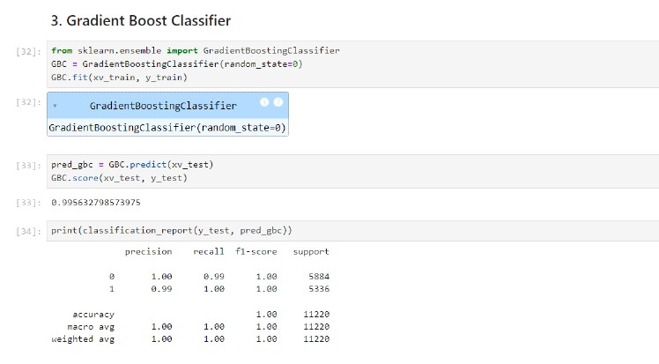
Gradient Boost Classifier
The Gradient Boost Classifier is a machine learning algorithm that builds a strong predictive model by combining multiple weak learners (typically decision trees) in a sequential manner.
Purpose:
To sequentially train a series of weak learners to correct the errors made by the preceding models.
To ensemble these weak learners into a strong predictive model.
Applications:
Predictive modeling in various domains, including finance, healthcare, and marketing.
Fraud detection.
Figure : Gradient Boost Classifier
Faculty of Engineering & Applied Sciences
06 - 2024
25

Slide 26
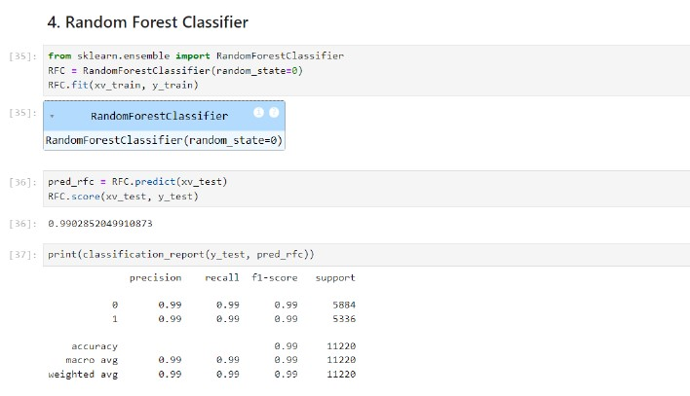
Random Forest Classifier
It can be used for both Classification and Regression problems in ML. It is based on the concept of ensemble learning, which is a process of combining multiple classifiers to solve a complex problem and to improve the performance of the model.
The greater number of trees in the forest leads to higher accuracy and prevents the problem of overfitting. It takes less training time as compared to other algorithms.
Applications:
Classification tasks where accurate predictions are required, such as in spam detection, image classification, and medical diagnosis.
Regression tasks where predicting continuous outcomes, such as in predicting house prices or stock prices.
Figure : Random Forest Classifier
Faculty of Engineering & Applied Sciences
06 - 2024
26

Slide 27
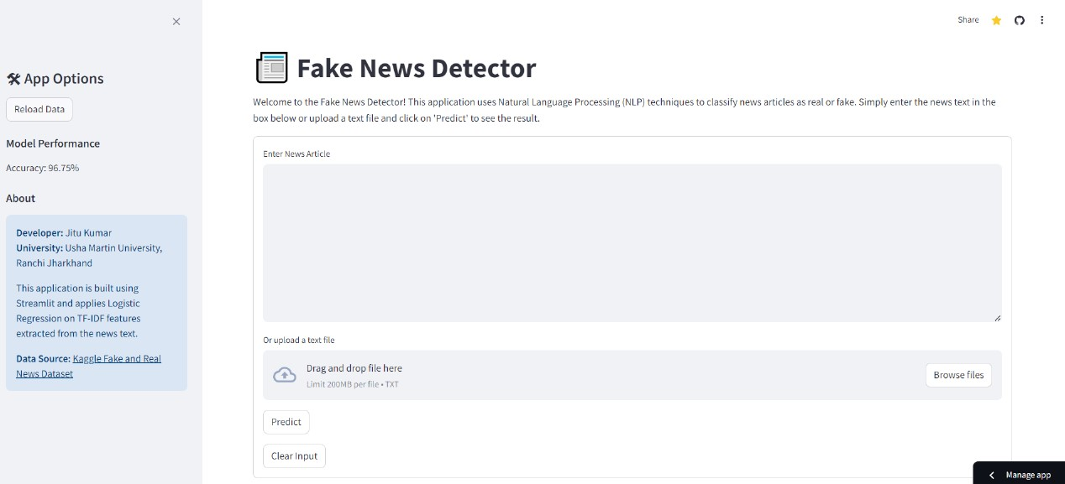
Verification
Here, users can enter information about a news article, and the model will tell them if that news is fake or real.
Figure : Model Testing
Faculty of Engineering & Applied Sciences
06 - 2024
27

Slide 28
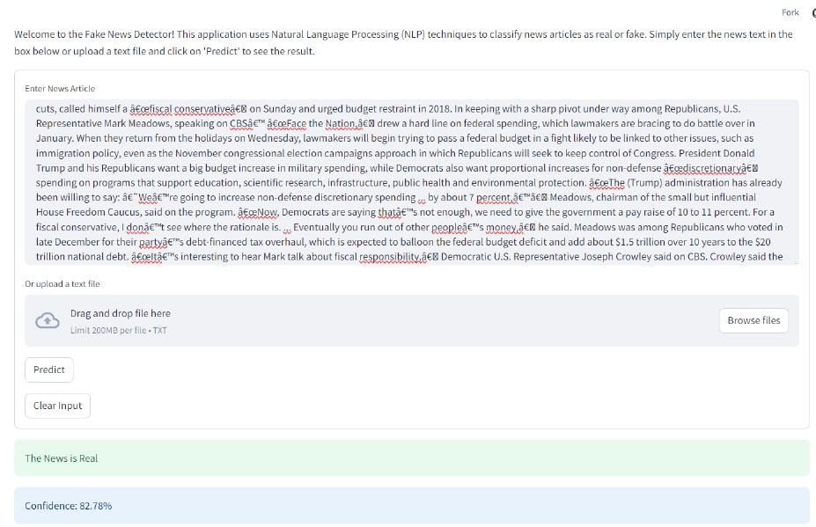
Model Testing For the True News
In the image provided, you can see the result based on the input I provided. The machine learning model thoroughly analyzed the data using various algorithms and confirmed that the news is true.
Figure : Verification for the True News
Figure : Verification for the True News
Faculty of Engineering & Applied Sciences
06 - 2024
28

Slide 29
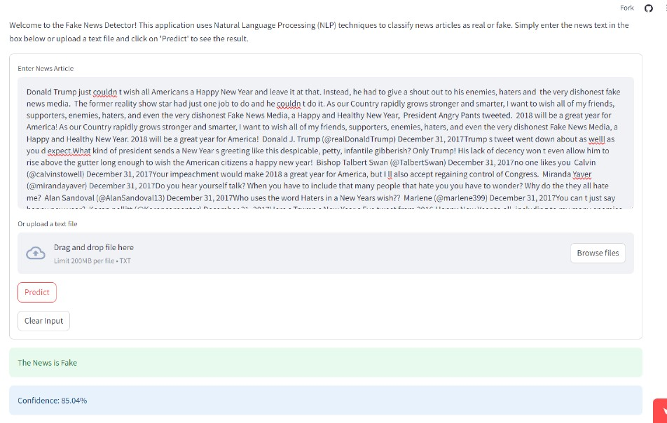
Model Testing For the Fake News
In the image provided, you can see the result based on the input I provided. The machine learning model thoroughly analyzed the data using various algorithms and confirmed that the news is fake.
Figure : Verification for the Fake News
Faculty of Engineering & Applied Sciences
06 - 2024
29

Slide 30

Conclusions
Successful Detection: Our machine learning models demonstrated promising results in accurately distinguishing between real and fake news articles.
Model Performance: The program we picked did a really good job. It was right most of the time and could handle different kinds of news stories.
Impact : Detecting fake news helps people trust what they read and stops false information from spreading, which keeps us safer and more informed.
Future Directions: We can make our programs even better by using more data and trying out new ideas. We want to keep making progress and make sure our programs are fair and accurate.
Continuous Improvement: We should always keep learning and trying new things to make sure our work stays helpful and trustworthy in the long run.
Faculty of Engineering & Applied Sciences
06 - 2024
30

Slide 31

Faculty of Engineering & Applied Sciences
06 - 2024
32

Slide 32

Faculty of Engineering & Applied Sciences
06 - 2024
31

